Slide 1
Introduction to the Transfer Pathway for the Master’s Degree in Diplomacy & Strategic Affairs (MDSA) at the University of St. Thomas
Dr. Yao-Yuan Yeh (葉耀元)
University of St. Thomas, Houston
yehy@stthom.edu

Slide 2
Who am I?
University of St. Thomas, Houston
Professor and Fayez Sarofim - Cullen Trust for Higher Education Endowed Chair in International Studies
Chair, Department of International Studies & Modern Languages
Chair, Department of Political Science
Director, Master of Diplomacy & Strategic Affairs Program
Director, Taiwan & East Asia Studies Program
Director, Mandarin Center of the Universities of St. Thomas and Wenzao Ursuline
Ph.D. (Texas A&M University) and B.A. (National Taiwan University) in Political Science
Specialized in International Security, Foreign Policy, US-Taiwan-China relations, Public Opinion, Research Methodology

Slide 3
The University of St. Thomas
The private Catholic University located in the center of Houston, Texas (address: 3800 Montrose Blvd., Houston, TX 77006 USA)
Established in 1947
A diverse student body
About 4,000 students (undergraduates and graduates combined)
Ranked No. 4 of 23 universities in the State of Texas by Forbes in 2023
For more information: https://www.stthom.edu/Home/Index.aqf

Slide 4
Houston
The fourth-most populous city in the United States: 2.3 million
The fifth-most populous metropolitan area in the United States: 7.1 million
The most diverse city in the United States
Weather: same as Taiwan, hot and humid
Most people commune by cars

Slide 5
The MDSA Program
Master in Diplomacy & Strategic Affairs (MDSA)
Established in 2020
Train learners to view global issues and conflicts through a holistic interdisciplinary prism
Apply diverse methods to understanding key issues and solutions
Promote diplomacy and diplomatic behaviors as central to effective problem-solving
Wide applicability to both public and private industries

Slide 6
The MDSA Program: Faculty and Expertise
Dr. Hans Stockton, Ph.D. in Political Science, Texas A&M University, specializing in East Asian politics, democratization, elections, and security
Dr. Ulyses Balderas, Ph.D. in Economics, University of Colorado Boulder, specializing in economic development and Latin America
Dr. Stan Wong: Ph.D. in Political Science, UCLA, specializing in Hong Kong and Chinese politics and authoritarian politics
Dr. Tuba Unlu Bilgic: PhD. In Political Science, Georgetown University, retired diplomat from the Ministry of Foreign Affairs in Turkey, specializing in foreign policy, international law, European and Middle Eastern politics
Prof. Eric Botts: Retired Foreign Service Officer from the US State Department, specializing in diplomacy and cybersecurity

Slide 7
The MDSA Curriculum Structure
30 credit-hour (10 courses)
Master thesis is not required
MDSA Primary CORE REQUIREMENTS (12 CREDIT HOURS)
MDSA 5301 Introduction to Diplomacy & Strategic Studies
MDSA 5302 Statistics for Political Science
MDSA 5303 Advanced Seminar
MDSA 6399 Capstone Course - Diplomacy & Strategic Studies

Slide 8
The MDSA Curriculum Structure
30 CREDIT-HOUR (10 COURSES)
MDSA Secondary CORE ELECTIVES (12 CREDIT HOURS, CHOOSE FOUR AMONG THE FOLLOWING COURSES)
MDSA 5351 Comparative Political Systems
MDSA 5352 International Politics
MDSA 5334 International Political Economy
MDSA 5355 Intercultural Issues
MDSA 6354 American Foreign Policy Process
MDSA 6364 International Law
MDSA 6393 Special Topics in Diplomacy & Strategic Affairs
MLPOS 5373 Public Administration Ethics
MDSA GENERAL ELECTIVES (6 CREDIT HOURS): Any MDSA courses

Slide 9
Transfer Pathway to the MDSA Program
A pathway for Tamkang University master’s students in International Affairs and Strategic Studies to finish the Master’s degree in the MDSA program in ONE YEAR (two semesters, with 9 credit hours/3 courses per semester and a total of 18 credit hours)
General Guidelines
The Graduate Institute of International Affairs and Strategic Studies at Tamkang University will nominate candidates at the beginning of the semester prior to initiation of study and inform the Department of International Studies & Modern Languages at UST
The MDSA Program at UST will extend to Tamkang master’s students in International Affairs and Strategic Studies all possible considerations for transferring a total of up to twelve (12) Tamkang graduate credits toward the UST degree
Applicants from the Graduate Institute of International Affairs and Strategic Studies at Tamkang University must have completed at least one full-time semester of studies and be in good academic standing prior to beginning classes at UST
The Department of International Studies & Modern Languages at UST will review the academic credentials of the candidate to ascertain if the candidate meets admission requirements

Slide 10
Application
The deadlines for the nomination of candidates from the Graduate Institute of International Affairs and Strategic Studies at Tamkang University
March 27 for fall admission
September 22 for spring admission
As we just started this program, the deadlines can be discussed
Meanwhile, the nominated students need to:
Submit the application to the MA in MDSA program online: https://myust.stthom.edu/portal/apply (choose Graduate Applicants -> Masters -> Register your account -> Selection MA in MDSA)

Slide 11
Application
Application requirements:
Official transcripts of all college-level work, including bachelor’s and master’s degrees
Two current letters of recommendation from academic or professional sources submitted on official letterhead
Resume or Curriculum Vitae
Two-page essay describing the applicant’s academic goals and interests in diplomacy and strategic affairs
Submit proof of English proficiency: 213 TOEFL CBT, 79 TOEFL IBT, 550 TOFEL ITP, 6.5 IELTS, or 125 Duolingo
Please contact Graduate Admissions at gradprograms@stthom.edu with questions about the application process

Slide 12
VISA, Immunization, and Health Insurance
The Office of International Services and Study Abroad will issue the admitted applicants with Form DS-2019 for obtaining the J-1 Exchange Visitor visa unless you are already a U.S. Citizen or Permanent Resident
Upon acceptance into your academic program, an OISSA Advisor will provide further information on what documents are needed for Form DS-2019 issuance. You will need the Form DS-2019 in order to apply for the J-1 Visa
Students will be required to submit appropriate immunization records
An OISSA Advisor will provide you with the detailed requirements for health insurance as part of the J-1 Exchange Student visa and immigration information. All J-1 international students are required to provide proof of health insurance before arriving in the U.S

Slide 13
Tuition and Fee
Tuition: $500 per credit hour, $4,500 per semester
Fees: $350 per semester
Total cost of tuition and fees for the program: $9,700

Slide 14
Housing
You may only sign up for student housing after you have been officially accepted to our university
You would like to secure it ASAP
A $300 security deposit will be required to secure your student housing
Off-campus housing is available, but you need to search them by yourself
https://www.zillow.com/houston-tx/rentals/
https://www.apartments.com/houston-tx/
Remember, public transportation is not convenient in Houston unless you acquire and drive a car

Slide 15
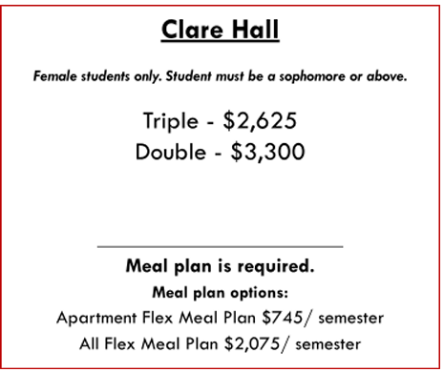
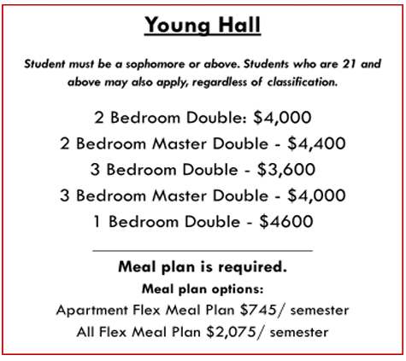
Housing

Slide 16
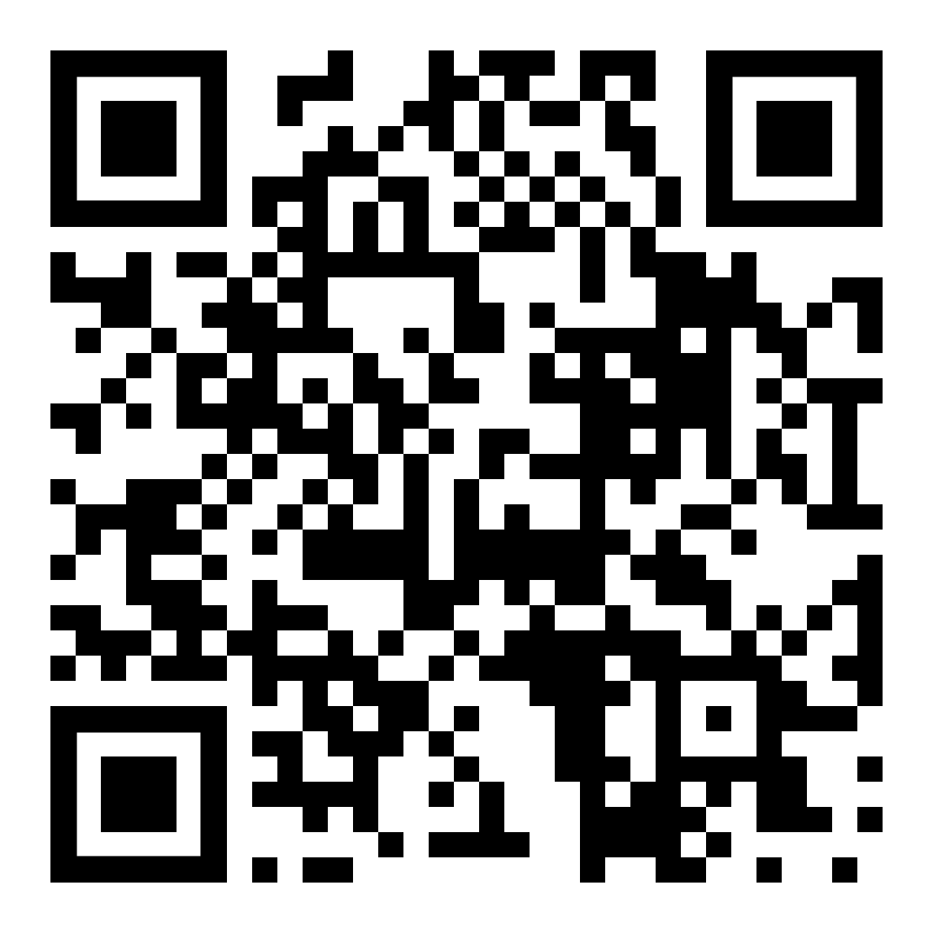
Thank you for your attention
Any questions?
Scan the QR Code to find me on Facebook, or send me an email at yehy@stthom.edu

